Slide 1
KMART
Delivery Assist
See the order. Understand the problem.
Choose the recovery. Finish it.
Dingchen Yuan · Taariq Mohamed · Huy Nguyen
WES · SAP Build 13 · five minutes
Notes:
BARRY · 0:00 to 0:15. Good morning. We are here to show the customer face of delivery recovery. The app is open. I will spend most of the five minutes inside it. Title only. Do not read the subtitle.

Slide 2
SITUATION
The order is already in the business.
The customer still cannot see one story.
Capital is in delivery
The order has a record
The customer gets fragments
CFCs and the online order system are there to make delivery faster and cheaper.
A sales order, an outbound delivery and a freight order already describe the journey.
A carrier page, then a phone call, then a refund somewhere else.
Kmart Delivery Assist · Managing Director
2 / 12
Notes:
BARRY · 0:15 to 0:40. Situation only. Kmart has already invested in fulfilment. The sales order, the outbound delivery and the freight order exist. What the customer meets is still a carrier page and a call. Stop. Do not mention the matrix yet.

Slide 3
COMPLICATION
A failed delivery becomes an exception
nobody closes with the customer.
The customer
Cannot tell a delay from a failed attempt, or choose the next step.
The order
Waits. A redelivery, a collection, a replacement or a refund are separate queues.
The result
Service slips, and a completed order — the outcome the programme protects — is lost.
Kmart Delivery Assist · Managing Director
3 / 12
Notes:
BARRY · 0:40 to 1:05. Complication. Say the three lines slowly. End on this sentence: the customer cannot finish the recovery, so the order stays an exception. Then go to the resolution.

Slide 4
RESOLUTION
One Kmart journey. One service request.
01
02
03
04
05
06
Track my
order
Understand
what is happening
Identify the
problem
Choose
what to do
Track the
recovery
Complete
refund/replacement
The customer stays in Kmart. The case is a SAP service request on the sales order.
Demo order KM185002 — the damaged storage box.
Kmart Delivery Assist · Managing Director
4 / 12
Notes:
BARRY · 1:05 to 1:30. Hand over to Huy at the end. Read the six steps only as a path, not as a list to memorise. Point at the screen if the app is already projected. Tell them the demo order is KM185002, the damaged storage box. The cushion in the same order is fine, so a refund is eighteen dollars, not thirty.

Slide 5
WHY THIS SOLUTION
A2 chose the data foundation first.
This pool can run the customer recovery.
A2, DO FIRST
PROTOTYPE NOW
P2 decision data
Weighted 4.50.
Needs OMS, WMS, TMS and Finance.
Delivery Assist
Same exception goal.
Sales order, delivery, freight, service request.
A2, LATER
NOT ENOUGH
P1 routing automation
Weighted 4.10.
Only after shadow evidence.
A status page with no recovery
Low effort, low impact.
Kmart Delivery Assist · Managing Director
5 / 12
Notes:
HUY · 1:30 to 1:55. Start from the A2 effort-impact result, do not invent a new winner. P2 scored 4.50 and stays the programme. P1 scored 4.10 and waits for shadow evidence. Say why the prototype is Delivery Assist: the API pool has no routing service and no cost dictionary, so the internal foundation cannot be built here. The pool can read the order journey and open a service request. That is the exception the customer feels. A status page with no choice does not recover it.

Slide 6
DESIGN · OPTION 3
The solution changed. The new models are in the prototype.
Empathise
A failed delivery is a dead end.
NEW MODELS
Define
One job: see it, choose, finish.
AS-IS
Carrier page, then a phone call, then a separate refund queue.
TO-BE
One Kmart journey. One service request.
Not available
The billing API cannot create a refund. The app confirms it and links the sales order.
Ideate
Picked the recovery journey.
Prototype
Six steps, one case.
Test
Refund asks twice. A healthy order stays healthy.
Kmart Delivery Assist · Managing Director
6 / 12
Notes:
HUY · 1:55 to 2:20. This is option 3, not a small wrapper change. Name the five stages once: empathise, define, ideate, prototype, test. Then the models. AS-IS file is design/A3_AS-IS_Customer_Exception.bpmn. TO-BE file is design/A3_TO-BE_Delivery_Assist.bpmn. Say the billing API can read, reject or delete, and cannot create a refund. Do not claim a live refund posting. The write we do have is the service request.

Slide 7
EASE OF USE
Nielsen’s ten heuristics, each tied to a screen.
1 Status
Step x of 6 stays on screen.
2 Real world
“Track my order”, not SAP codes.
3 Control
Back, and start the order again.
4 Consistency
One button, one step pattern.
5 Prevention
A refund is named, then confirmed.
6 Recognition
Recent orders are visible.
7 Flexibility
Order number or sales order.
8 Aesthetic
One decision on each screen.
9 Recovery
A missing order says what to check.
10 Help
Each screen says what happens next.
Kmart Delivery Assist · Managing Director
7 / 12
Notes:
HUY · 2:20 to 2:35. Do not read all ten. Say: status stays visible, the words are the customer’s, a refund asks twice, and a healthy order is not forced into a problem. The other six are on the slide if asked. Hand over to Taariq.

Slide 8
UNDER THE HOOD · SAP
Real SAP data in. Exact SAP requests out.
READ LIVE
WRITE · SIMULATED
BUILT THE LAB WAY
Sales Order API
API_SALES_ORDER_SRV
Order, items and delivery status ($top, $select, $expand).
Purchase Order API (OData V4)
Supplier orders, items, schedule-line dates.
Service request
OP_API_SERVICE_REQUEST_SRV_0001
Purchase-order items, schedule lines, notes.
The sandbox is read-only (POST returns 405), so each request is built in exact OData format, saved and shown on screen. One setting switches to live S/4HANA.
SAP Integration Suite: API proxy and MCP server deployed.
OpenCode prompts with the API spec, sandbox URL and API key.
If the sandbox is down, the app falls back to the last saved SAP snapshot.
Kmart Delivery Assist · Managing Director
8 / 12
Notes:
TAARIQ · 2:35 to 2:55. Twenty seconds. Say: the order data is read live from the SAP sandbox with our API key. The sandbox does not allow writes, so every write is built in the exact SAP format and shown in the app, ready for production. We deployed the API proxy and MCP server in Integration Suite and built the app with OpenCode prompts. Then go to the app.

Slide 9
SHOW IT
Order KM185002
ANKO Storage Box 30L · damaged on delivery · cushion is fine
1 Open the order. Read the one-sentence status.
2 Confirm the problem. Keep the recommended replacement.
3 Check for an update until the case is ready.
4 Confirm. Show the SAP service request.
Notes:
TAARIQ · 2:55 to 4:05. Leave this slide only if the app is not yet on screen. Preferred: the app is already full screen and you do not linger here. Clicks: Storage box. See the problem. This is the problem. Continue, replacement is already selected. Check for an update. Check again. Review the outcome. Confirm replacement. Open the SAP service request and point at the sales order 450218 and the service request API. If the demo fails, skip to the backup slide (12) and talk through the screenshots. Do not hunt for menus.

Slide 10
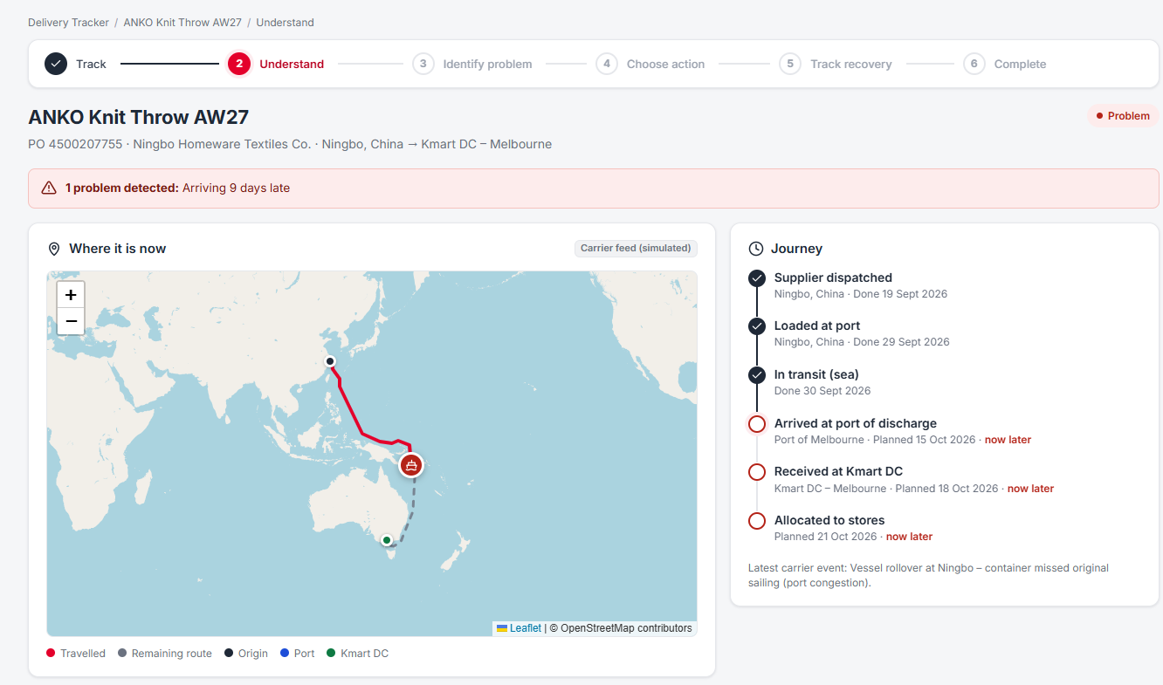
SAME EXCEPTIONS · BUYER SIDE
Before an order reaches a customer, the stock has to arrive.
Delivery Tracker
Inbound supplier orders on a map. SAP schedule lines flag a delay, short shipment, damage or supplier rejection.
Same recovery path
Expedite, replace, refund or re-source, each built as SAP purchase-order changes.
Mix-Lock
Defers the Anko colour and size split until early sell-through is in. Knit Throw markdown risk: $2,218 to $605.
Supply Hub · Delivery Tracker · Knit Throw, 9 days late (live SAP purchase order)
Kmart Delivery Assist · Managing Director
10 / 12
Notes:
TAARIQ · 4:05 to 4:30. Twenty-five seconds, no demo unless asked. Say: Delivery Assist is the customer face. Supply Hub, in the same app, is the buyer side. It catches the same kinds of delivery problems earlier, on the supplier purchase order, using the same SAP API. Mix-Lock reduces the markdown risk before stock is even shipped. Hand back to Barry for the ask.

Slide 11
THE ASK
Use this as the customer face
of exception recovery.
Today
A customer can finish a damaged, missed or missing delivery without a call.
Next
Supply Hub brings the same recovery to inbound supplier orders. Decision data and routing stay on the programme.
Guardrail
A refund is explicit. A healthy order is not turned into a case.
Kmart Delivery Assist · Managing Director
11 / 12
Notes:
BARRY · 4:30 to 4:50. Close on the ask, not a summary of every slide. Today the customer can finish the recovery. The heavier routing work stays later. A refund is a decision, not a side effect. Thank them and take one question. Then the disclaimer slide is for the upload, not for a speech.

Slide 12
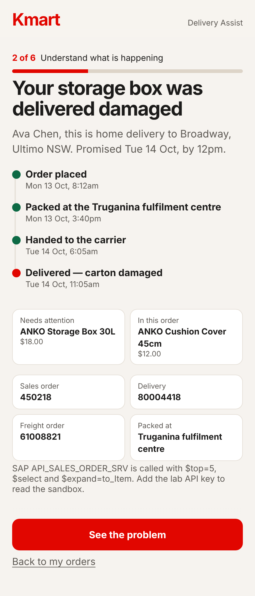
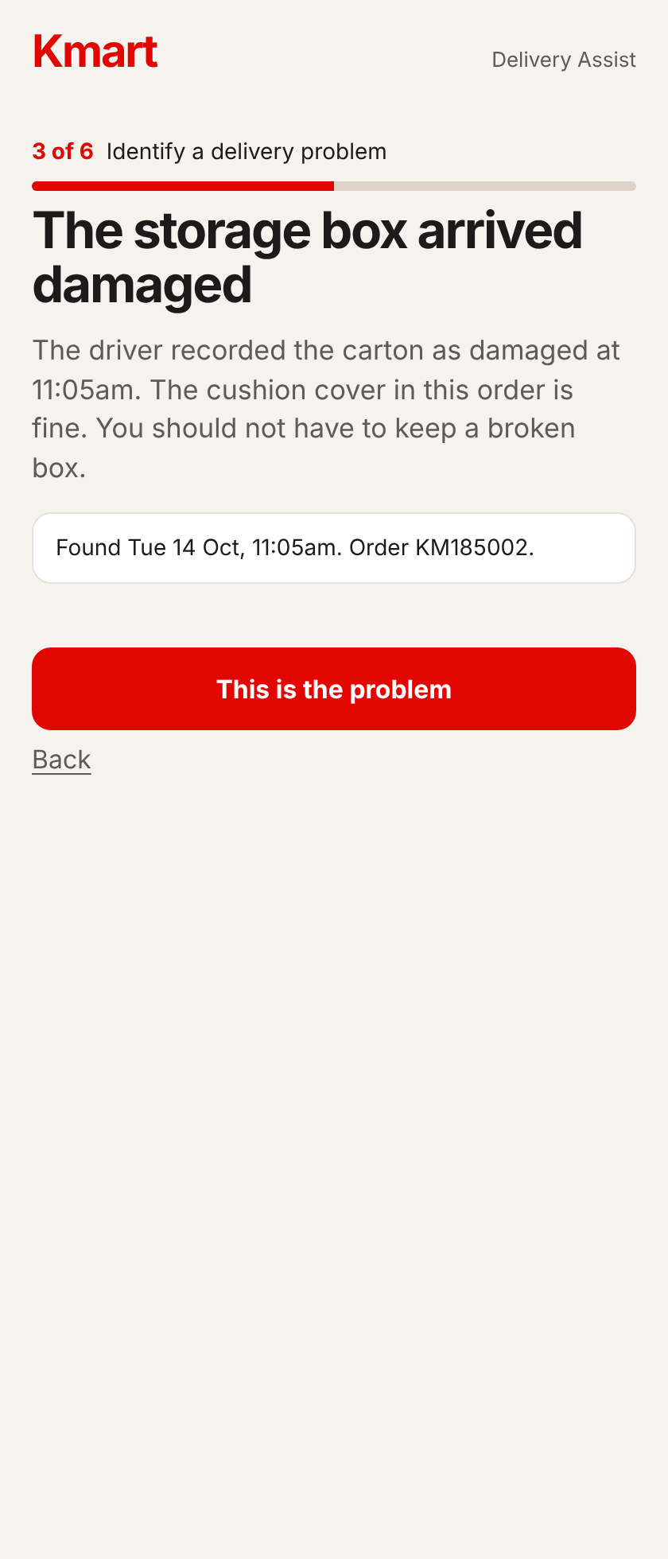
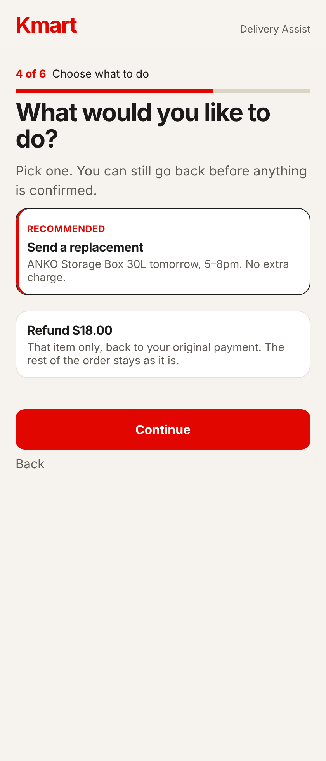
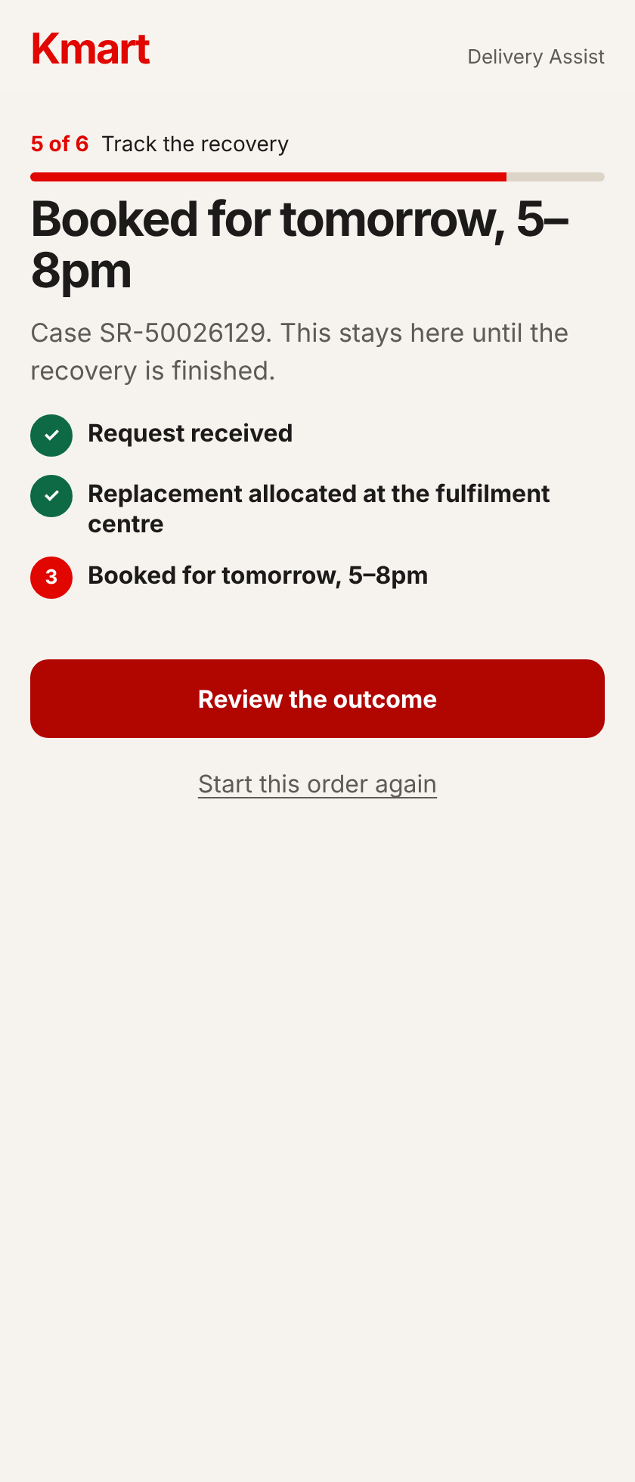
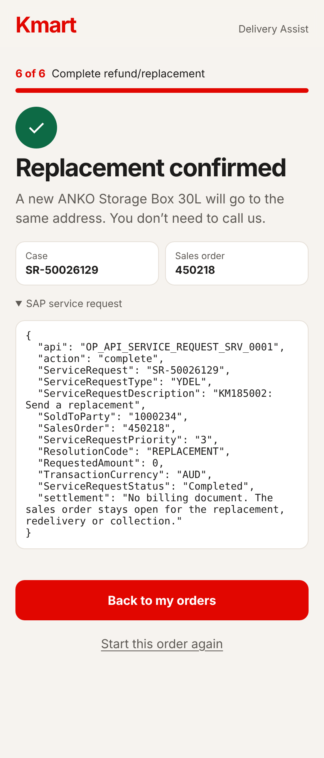
IF THE DEMO FAILS · ORDER KM185002
The same journey, screen by screen.
2 Understand
3 Identify the problem
4 Choose what to do
5 Track the recovery
6 Complete, with the SAP request
Kmart Delivery Assist · Managing Director
12 / 12
Notes:
Backup only. Use it if the app will not load in the lab. Talk through the five screens in under a minute, then go to the ask.

Slide 13
GROUPWORK MANAGEMENT DISCLAIMER
We take equal contribution in groupwork seriously, and marks may be deducted where there is a significant inequality in the team’s contribution. In the following table, state each group member’s contribution* to this assignment. You may also include any comments to support the % contribution indicated on the table.
*No contribution to the deliverable may result in a deduction of marks in the group assignment.
GROUP MEMBER | Dingchen Yuan | Taariq Mohamed | Huy Nguyen | Total
UPI | dyua155 | tmoh716 | hugn456
% Contribution | 34% | 33% | 33% | 100%
Comments | Equal split | Equal split | Equal split | Rounding
Criteria explanation:
1. UPI: Enter each team member’s UPI.
2. % Contribution: Enter a percentage for each member. The figures must add up to 100%.
3. Comments (optional): Add a comment where the percentage needs context.
Notes:
Do not spend speaking time here unless asked. This slide has to be last in the file. UPIs are filled in. Confirm the 34/33/33 split with the whole group. If the split changes, change the percentages so they still total 100.

